Slide 1



opentelemetry
An introduction to opentelemetry

Slide 2
What is opentelemetry?
Vendor-neutral standard
Tools, APIs and SDKs
Instrument, generate, collect and export
Open Source – 125 Contributors
Follows on from OpenTracing and OpenCensus
Notes:
OpenTracing – Traces only
OpenCensus – Traces + Metrics. Started by Google.

Slide 3
Why opentelemetry?
Standardised
Compatible with multiple services
Handles telemetry data transferral
Collector (high-level, elaborate later)
Used by Apple, JPMorgan, Amex

Slide 4
Tracing
What? | Why?
Recording the lifetime of a request | Exact recording of critical errors
A trace consists of a tree of spans | Record normal procedures for analysis
 | Identify edge cases

Slide 5
Spans
Context Extracted
Child Span
New Spans?
Request Handled
Context Injected
Span Finishes
Stopwatches
Contain tags, events, errors, duration
Represent work done by services/components
Context
Notes:
Plan exact wording of context explanation

Slide 6
Example traces & Spans

Slide 7
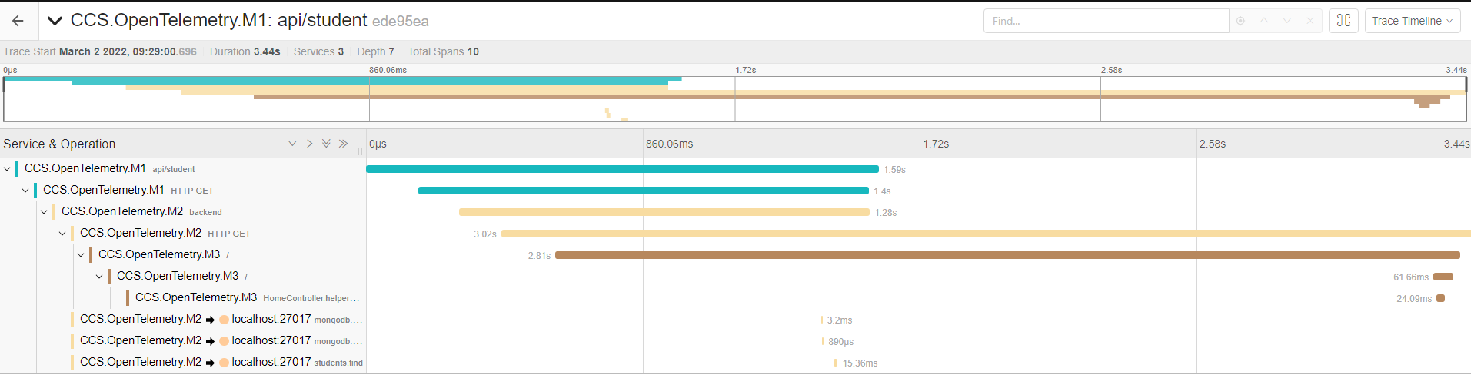

Slide 8
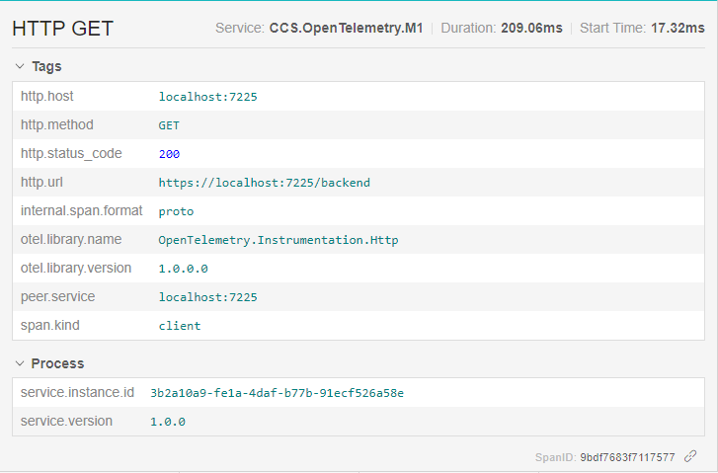

Slide 9
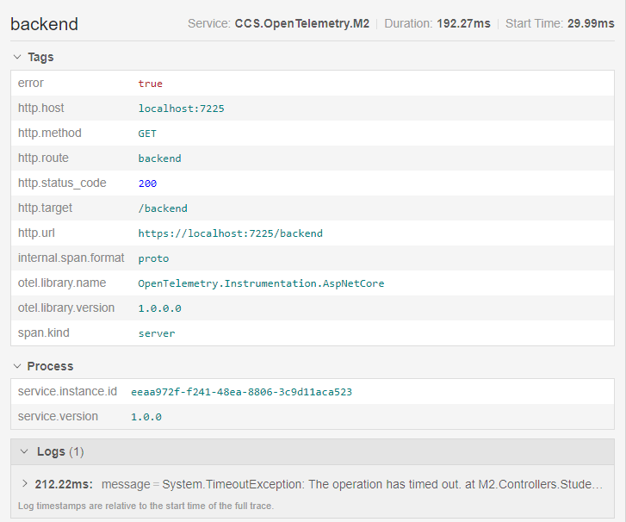

Slide 10
Metrics
Logs
Data recorded at regular intervals
Counters, measures, observables
Text
Timestamped
Contain Trace IDs

Slide 11
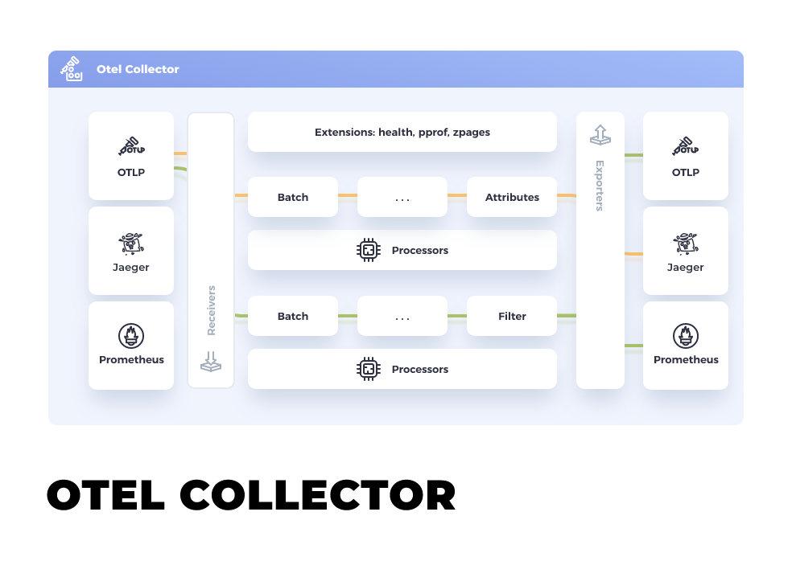
Collector
Middleman between services and observability tools
Can sample, filter and refine data
Contrib version offers extra functionality
Notes:
Contrib – not part of core distribution. Vendor-specific.

Slide 12
Instrumentation
Automatic | Manual
Creation and sending of spans handled for you | More control over how many spans
Libraries can extend to propagation | More control over data/metadata
 | Requires larger codebase for every feature added

Slide 13
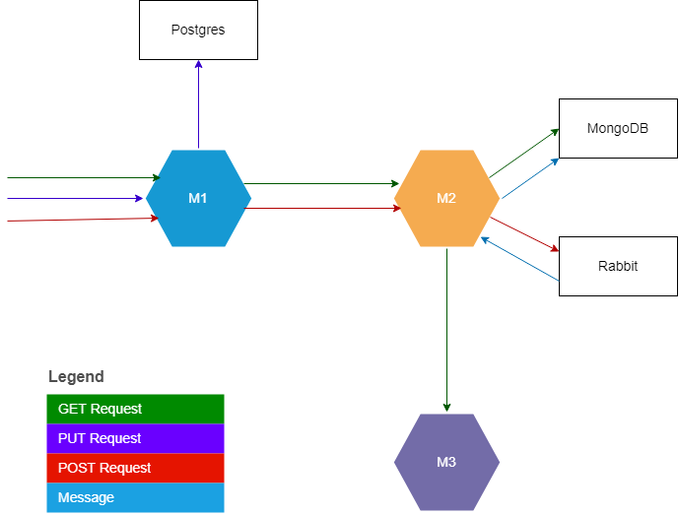
System Overview
User
Notes:
Create a telemetry diagram and put alongside sys diagram

Slide 14
Opentelemetry in .net 6.0

Slide 15
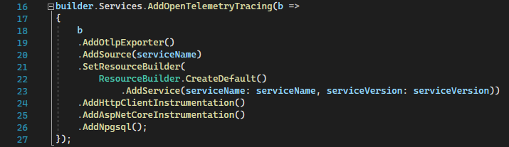

Slide 16
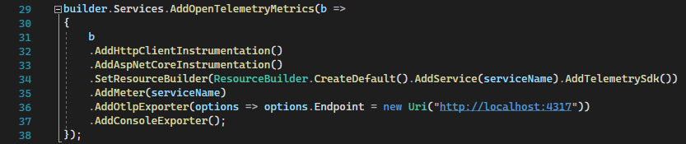
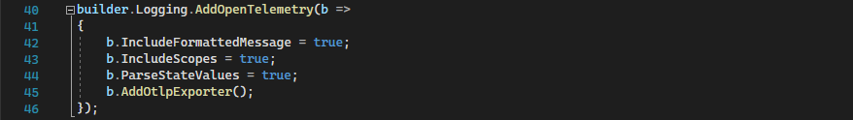

Slide 17
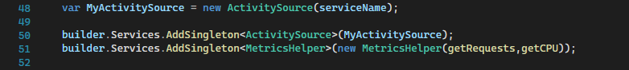

Slide 18
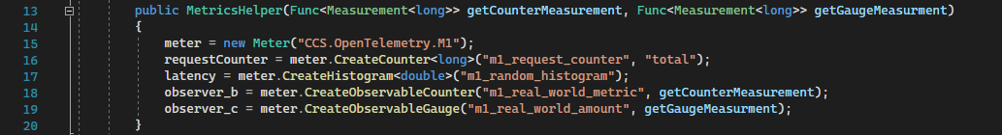

Slide 19
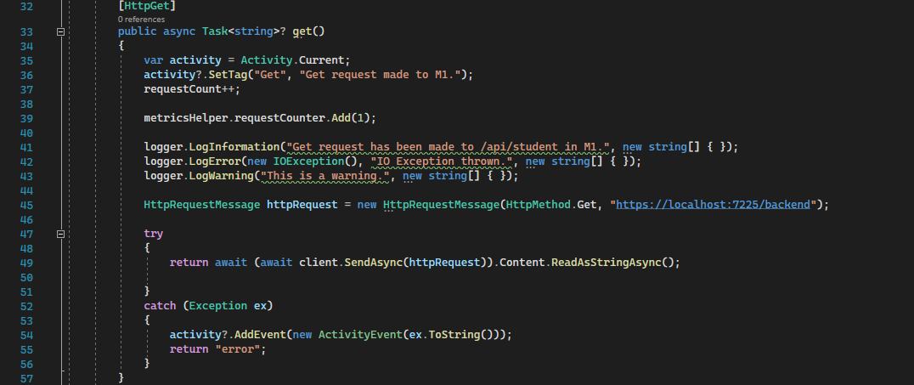

Slide 20
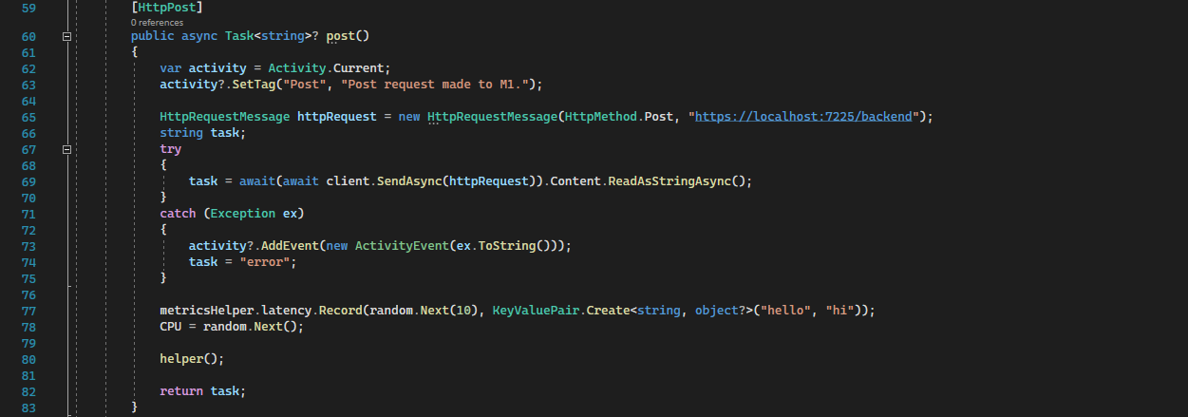

Slide 21
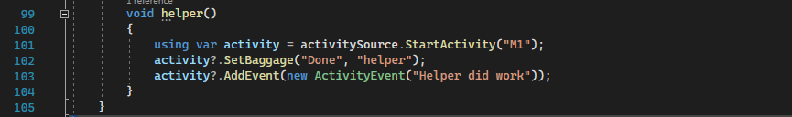

Slide 22
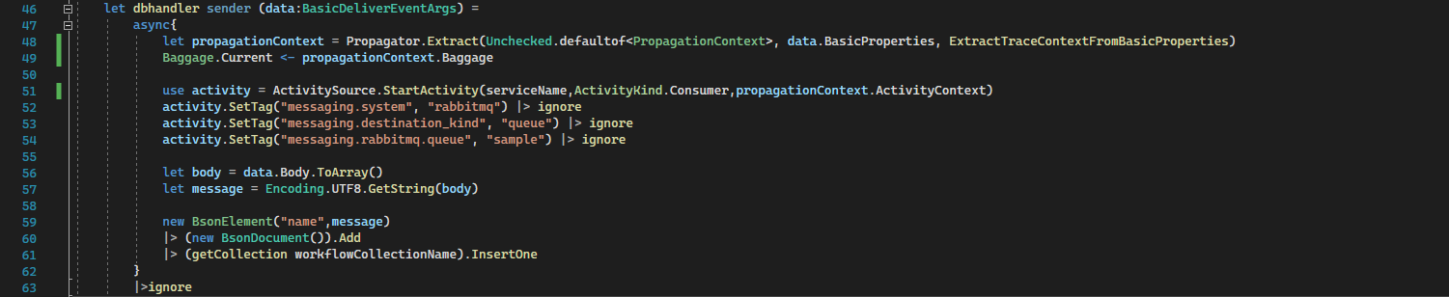

Slide 23
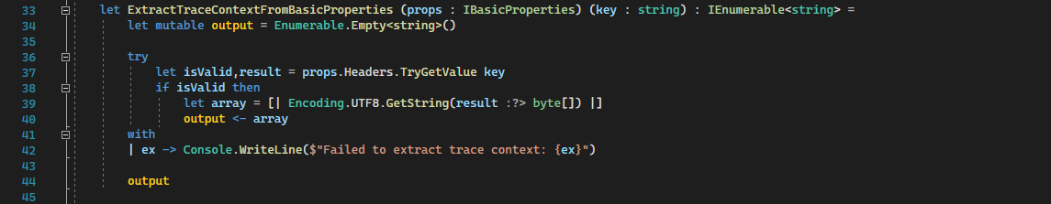

Slide 24
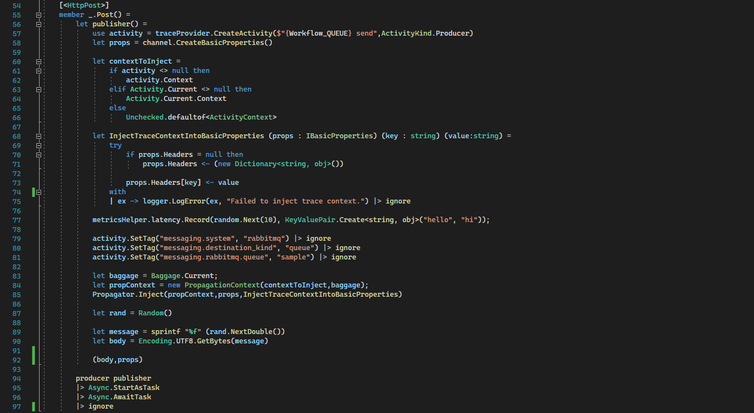

Slide 25
Collector configuration

Slide 26
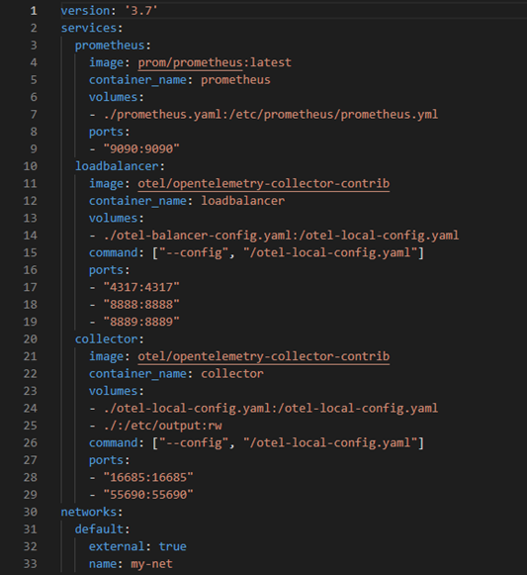
Notes:
docker-compose.yaml

Slide 27
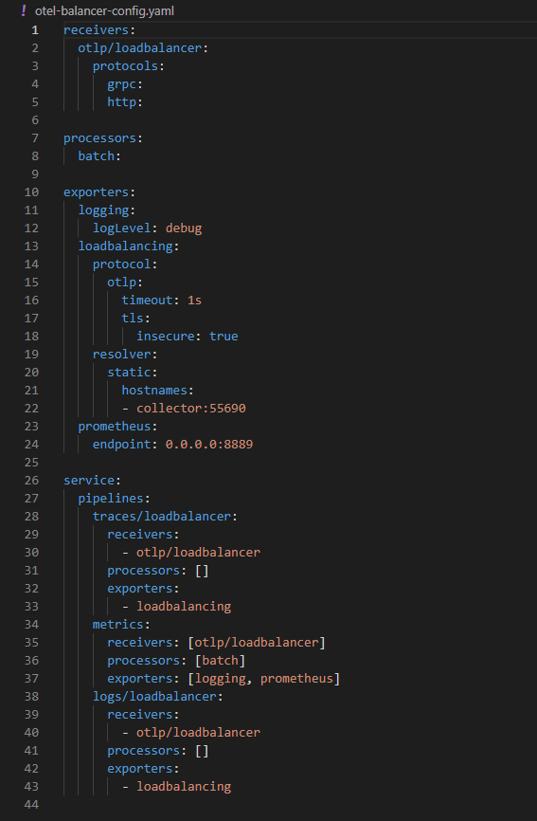

Slide 28
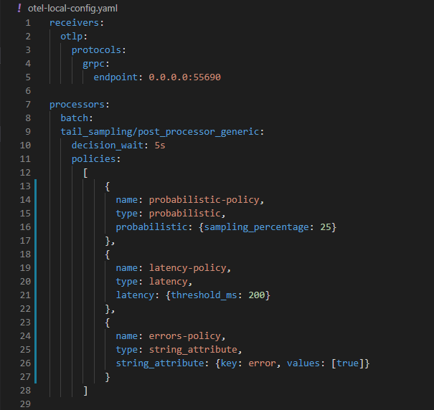
Notes:
Tail-sampling only occurs once trace is complete.
Policies are OR operators.

Slide 29
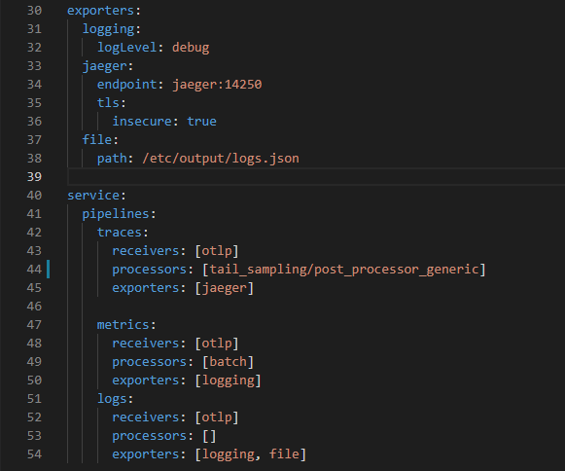

Slide 30
https://gitlab.com/workplacement2022/opentelemetry

Slide 31
Live demo

Slide 32
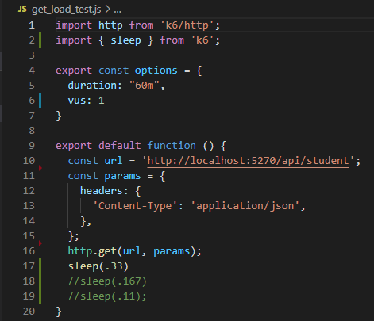
Load testing
Utilised k6 for load testing
Test cases varying in intensity

Slide 33
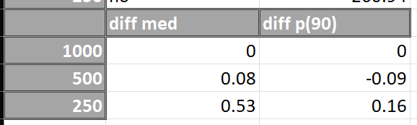
Impact of tracing

Slide 34

Go vs DotNet comparison

Slide 35
Further information
Potential tail-sampler deprecation
No unstable features
Industry usage of distributed tracing
Notes:
https://link.springer.com/article/10.1007/s10664-021-10063-9

Slide 36
Q&A

